Slide 2

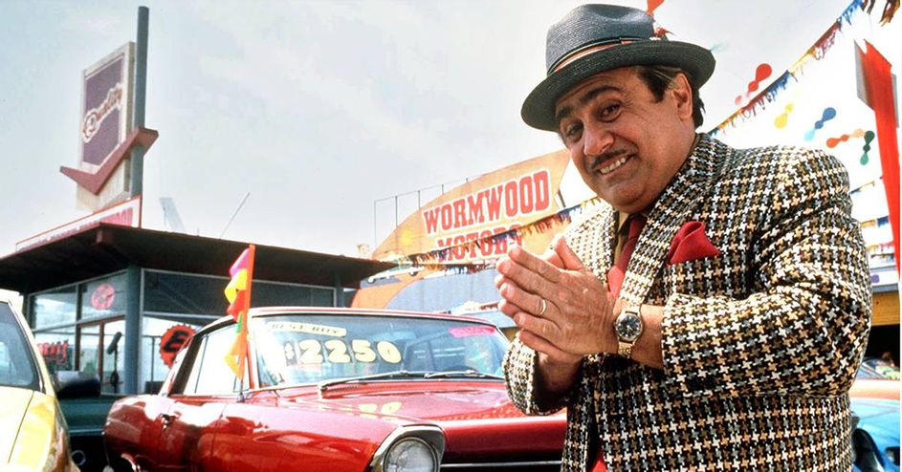

Street Smarts:
Outsmarting the
Used Car Salesguy
Group 2:
Ashley Guidot
Vishwanath Subramanian
Forrest Surles

Slide 3
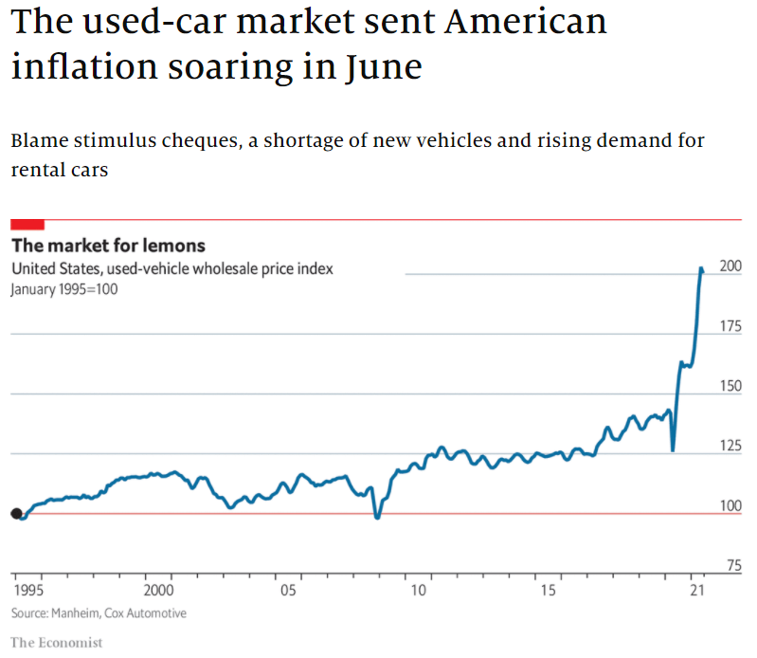
Overview
Used car market price rise of 45% in last 12 months
Lack of new electronic components
Inflation impact
Advances in online car purchasing through fintech allow for
Lower cost
Increased user power
Project focus on vehicle selection
Type
Condition
Odometer
Location
Notes:
The used car market is currently experiencing an all time high, due to the lack of electronic components for new car production and the impact of inflation on our economy. Our research leads us to focus on the used car market, which has seen prices rise by 45% during the last 12 months. This activity in the market corresponds to threats of rising inflation and potential increase in interest rates alongside news of ongoing supply shortages in automotive electronics.
Through the advances in fintech, an individual can quickly sell their car online and receive payment, all while staying in the comfort of their own home.
Our project will focus on analyzing used car sales data to navigate the best buying and selling opportunities in the current market. We will examine current geographical trends across vehicle type, specifications, mileage, and units sold as well as compare changes in the economic landscape.

Slide 4

Business Case
Establish a best deal service
Support car evaluations
Applies all parameters to purchasing
Regional hotspots and best overall sellers
Opportunities
Sell to help facilitate existing markets
Claim market dominance
Advertisements
Growth Plan
Notes:
Use our fintech skills to

Slide 5
Outline
Dataset
Kaggle Used Car Dataset from Craigslist Vehicle Listing
Analysis
Trends across sales, models, prices, etc.
Conclusion
Determine best opportunities in buying/selling in current regional market
Notes:
Our objective as a project team was to identify a current market phenomenon allowing us to utilize all the skills we have acquired thus far in the fintech course.

Slide 6

Group Approach
Breakdown
Forrest – Data extraction and cleanup
Vishwanath – cleanup, project management, and analysis
Ashley – visualization, analysis, and presentation
Notes:
Our group breakdown of the project started with Forrest extracting the data and cleaning it up to produce one csv file for us to analyze

Slide 7
Data Extraction
Original
Craigslist North American used vehicles sales
Largest collection of online used car sales
Scraped/updated every few months
Combined
2.5 million rows
26 columns
Cleaned Data
5 versions cleaned and combined
From 2018 - 2021
80778 rows
18 columns
Set index to UID
Restricted to continental US
NaN taken out
Notes:
Forrest last slide

Slide 8
Key User Stories
Data Extraction
Blank cells
Analysis
Regional comparison
Visualization
Map points
Condensing

Slide 9

Analysis
Case 1
Region: any 2 regions
Odometer: in a certain range
Condition: specific condition
Type: specific vehicle type
Case 2
Region: any 2 regions
Price: in a certain range
Condition: specific condition
Type: specific vehicle type
Notes:
San D = 97,096 double sample size of Houston
Houston = 94, 916

Slide 10
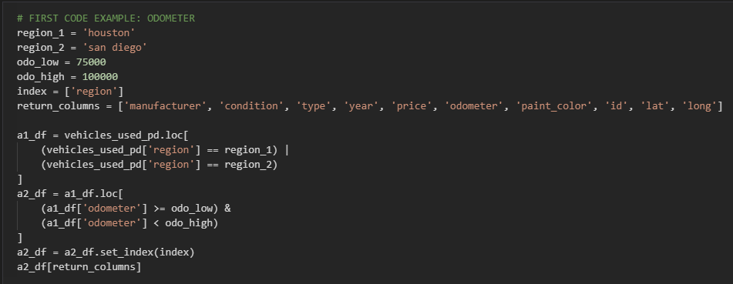
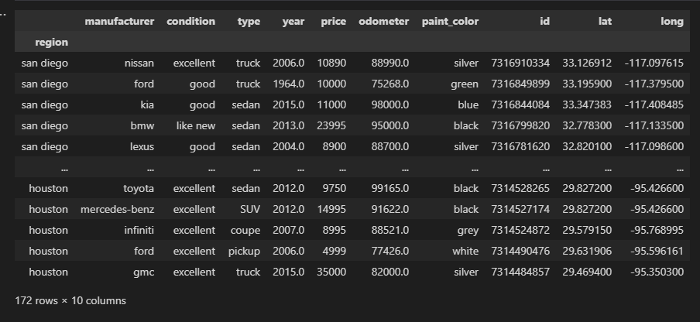
Analysis: Case 1

Slide 11
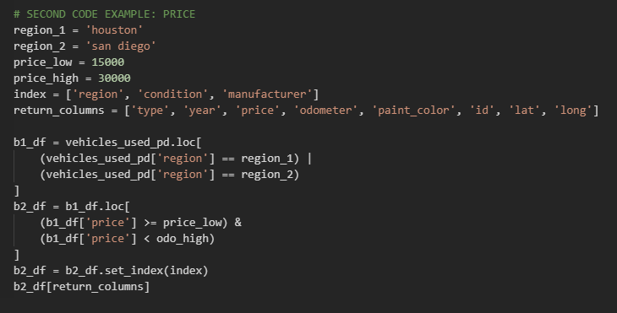
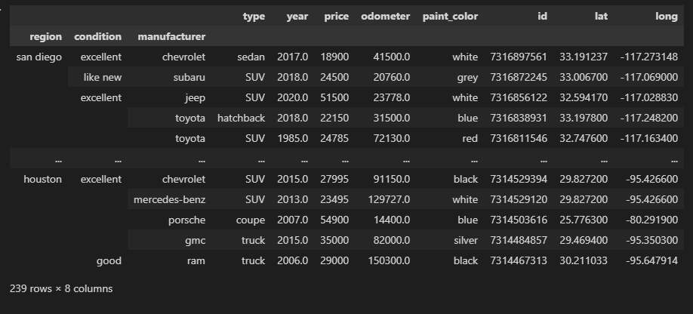
Analysis: Case 2

Slide 12
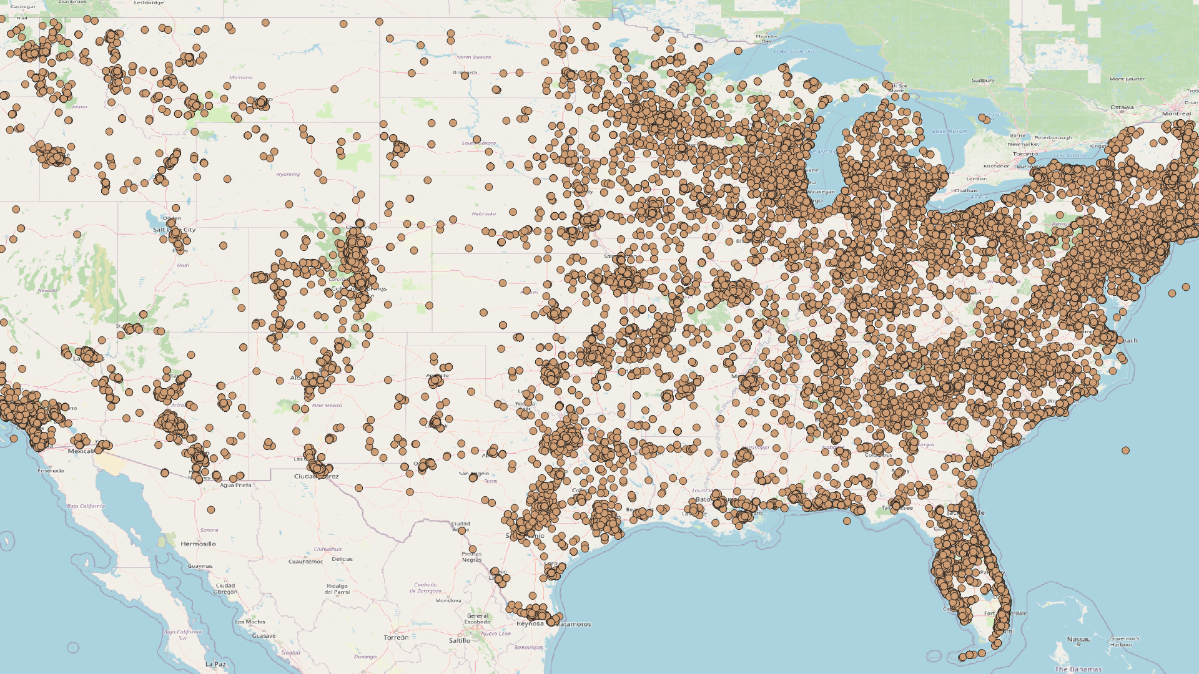
Map of Clean Entries
Notes:
Ashley
We used QGISS 3.16 to run the cleaned 80,000 data points on the continental United States. A majority of the current craiglist used car sales are located along the coast cities, especially within the northeast united states.
This data shows that there are more car sales within the larger American cities, where people need to travel farther to corporate jobs and use vehicles in order to get around.

Slide 13
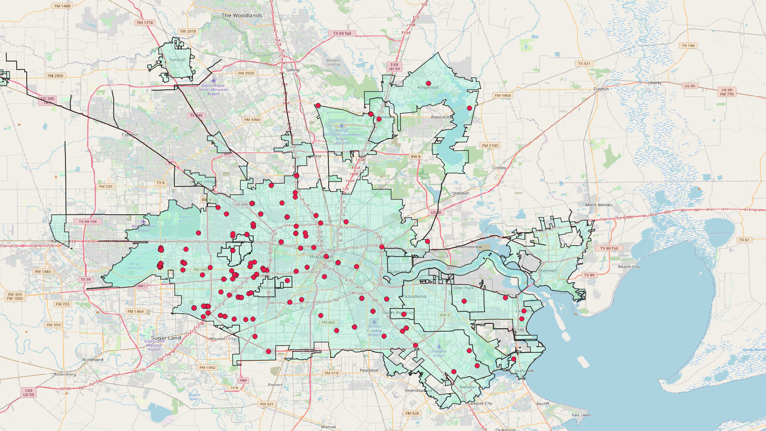
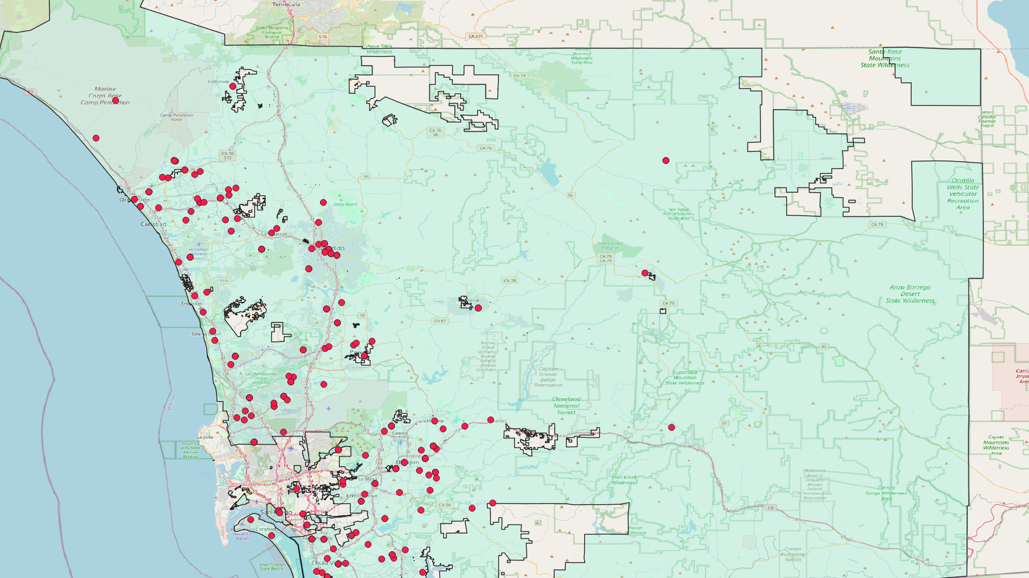
Map of Geographical Clean Entries
Houston
San Diego
Notes:
We have plotted the current cars sales in both Houston, Texas and San Diego, California. The reason we picked this to regional areas, were they were far enough apart and did not have contain too many sales listing so the data was both readable and easier to navigate.
As we mentioned earlier in this presentation, too many data points created issues for us being able to efficiently and effectively run code.

Slide 14
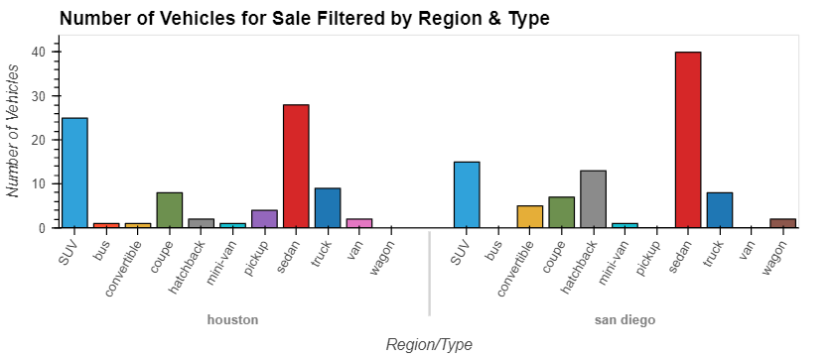
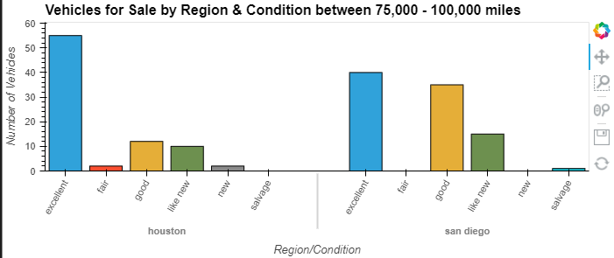
Visualization of Houston and San Diego
Notes:
This is a visualization of the type of vehicle in the Houston region in comparison to the San Diego. This was an important data analysis for us to understand what types of vehicles were being sold in these two different regions to understand the current demands of the market.

Slide 15
Summary
Working tool for buyer and seller
Better understanding of impact of vehicle condition on sales within different ranges
Numerous analytical possibilities
Limited by quality and data size
Price gouging
Notes:
When we were gathering our sample in for the regions of Houston, TX and San Diego, CA within the odometer range of 75,000 to 100,000 and comparing the conditions, manufacturers, and prices we identified key differences.
In San Diego, CA more cars close to 100,000 miles use the excellent condition in comparison to Houston, TX.
San D = 97,096
Houston = 94, 916

Slide 16
Recommendations
Seller
Analyze sell history
Buyer
Target based advertising
Compare margins to historical data in region
Leverage all parameters
Perform comparative analysis
Notes:
Lower Price compromise mileage
Lower Mileage compromise on price
Condition is

Slide 17
Future Opportunities
Next Steps
- Dealer Research Tool
- Individual Shopping tool
- Monte Carlo: Forecast Buyer Patterns
Questions

